Slide 1

Navigating the LLM Apps Development Framework Jungle
PyCon ID 2025, Jakarta

Slide 2
Rendy B. Junior
@rendybjunior (all social media)
VP of Data at Evermos
Data Analytics - Data Engineering - AI / Data Science
Previously:
Head of Data @ Ruangguru
Data Engineering Lead @ Traveloka

Slide 3
Goal of this talk
You’ll get a bigger picture what are the differences in philosophy of the LLM dev frameworks.
You’ll get an idea what features & components to expect for an LLM dev framework.
You walk away with mental model when to use which

Slide 4
Disclaimer
This talk is based on survey research, not high scale production experience.
The talk does not aim for comprehensive ecosystem survey, because there’s just too many of them.
The pace of improvement of the AI dev framework are aggressive, the features and limitation mentioned might get outdated pretty quick.
AI dev ecosystem is still not mature, so you’ll expect more experiments with a bit of uncertainty for the result.

Slide 5
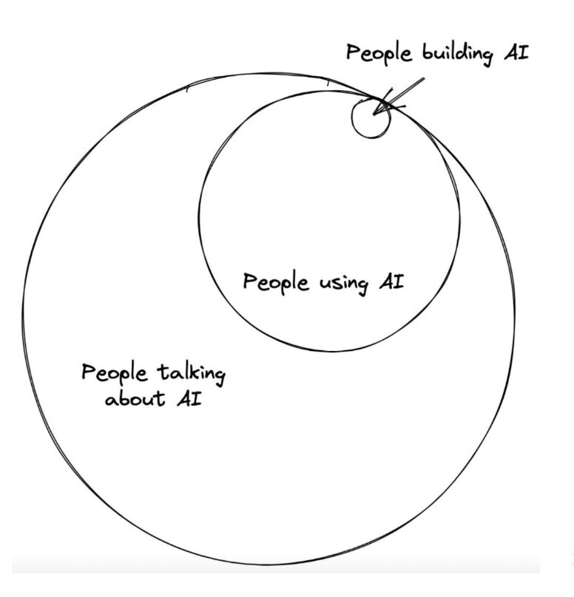
Why This is Important for us Software Engineers
Innovation
Foundation
Knowledge = Speed
Stay relevant

Slide 6
The Talk Structure
The Basics
The Comparison
  Design Philosophy
  Component and Features
  The Ops
The Mental Model
Honourable Mention
Closing

Slide 7
OK. Let’s start with the basics

Slide 8
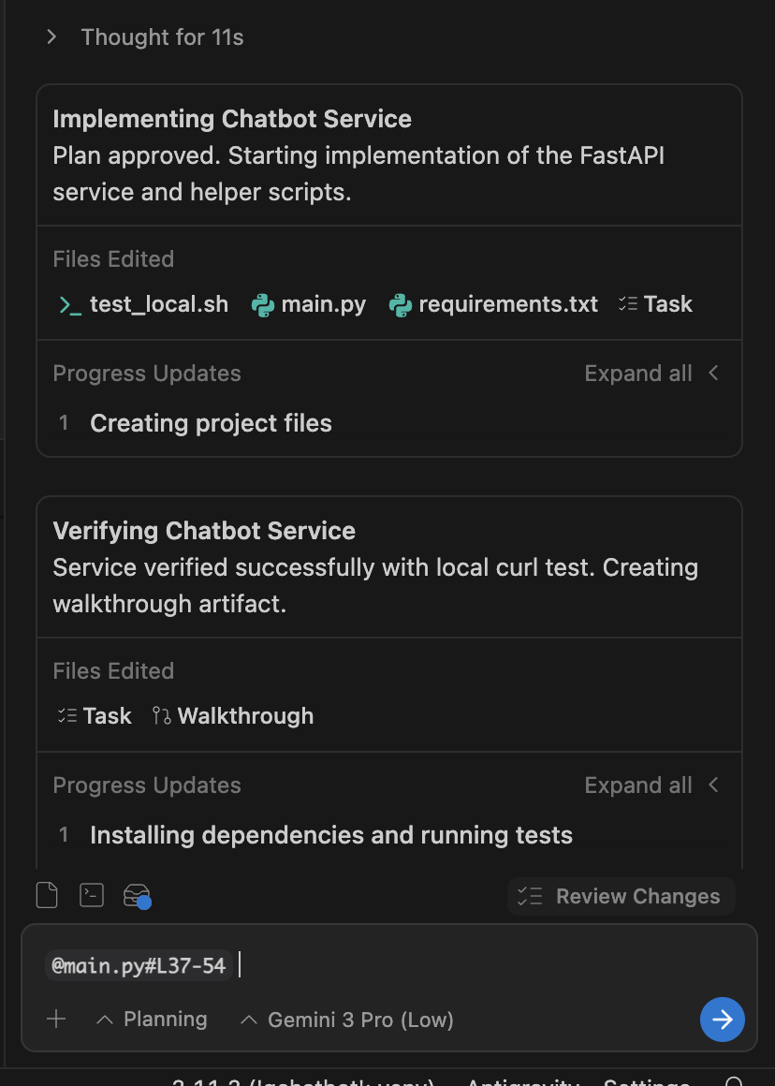
In 2023/2024, we ask LLM chat to consult.
>> fast forward…
In 2025, we ask the AI agent to write the code.

Slide 9



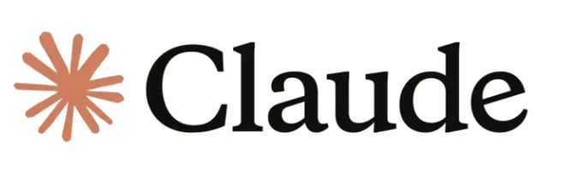
Agentic LLM Apps
Agentic LLM Apps do planning and take actions by connecting to tools, such as external tools and APIs.
Properties:
Use ReAct: Reasoning and Act
Call tools and API
Example:
Travel agent chatbot, do planning and booking
AI Coding IDE
Input
Action
(API, etc)
db

Slide 10
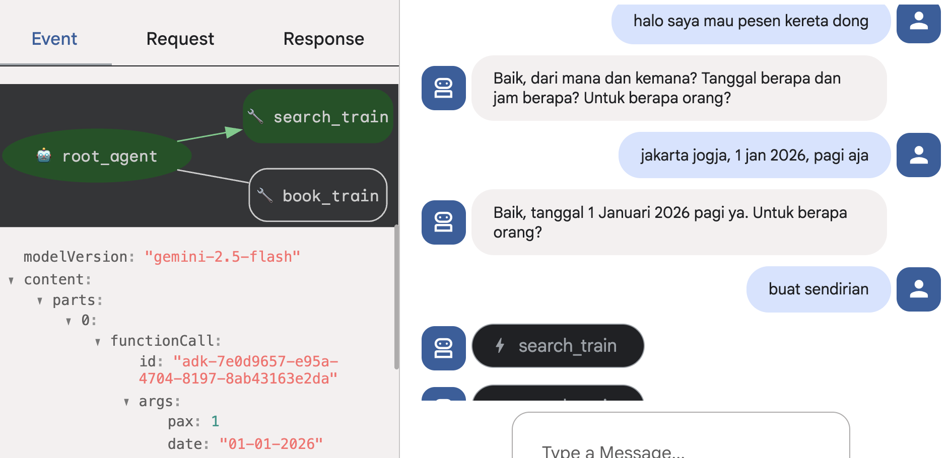

Slide 11
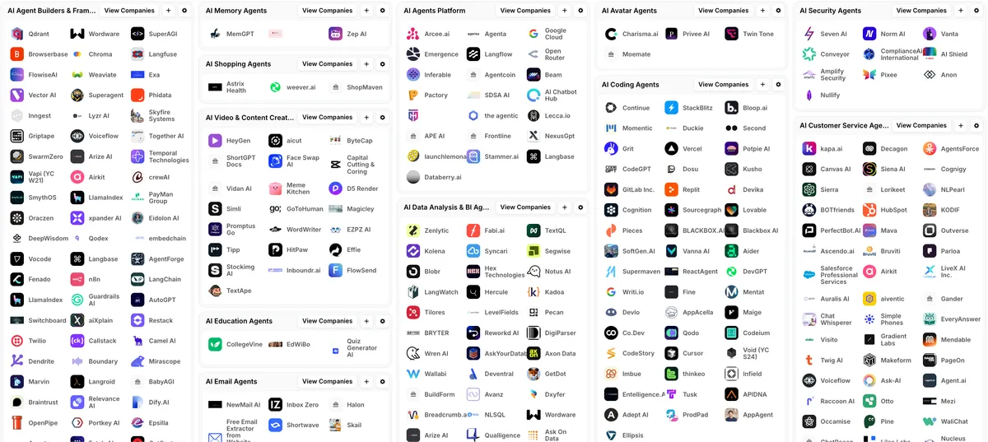
The Problem is…

Slide 12
Let’s Navigate
the Jungle of Framework Now!

Slide 13
The Comparison
The Survey Aspect
Design Philosophy
Component & Features
Scalability & Observability
Learning Curve
The Framework Chosen
The rising star: CrewAI
The pioneer: LangGraph
The No Code: n8n
The Vendor-centric: Google ADK

Slide 14
The Design Philosophy Differences

Slide 15
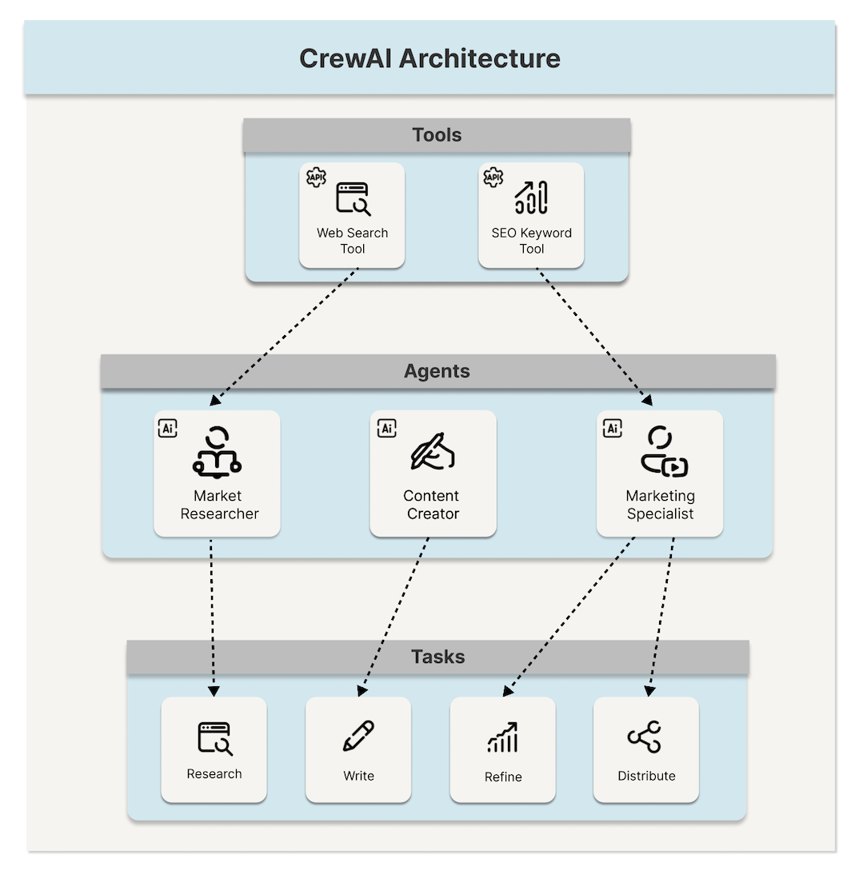
The Rising Star: CrewAI
Philosophy: agent collaboration.
Given task, create a crew of agents with specialized roles and tools, and let them collaborate to achieve the goals.
Characteristics: Simplicity and high level abstraction.

Slide 16
# Agent: The Researcher researcher = Agent( role='Senior Data Researcher', goal='Uncover developments in the field of AI Agent', backstory="You're a researcher with a knack for finding information with curiosity." ), tools=[search_tool] )

Slide 17
Why Crew of Agents?
Simple abstraction.
Opinionated: by certain role, backstory
Enables dynamic collaboration across agents.
# agents.yaml researcher: role: > {topic} Senior Data Researcher goal: > Uncover cutting-edge developments in {topic} backstory: > You're a seasoned researcher with a knack for uncovering the latest developments in {topic}. Known for your ability to find the most relevant information

Slide 18
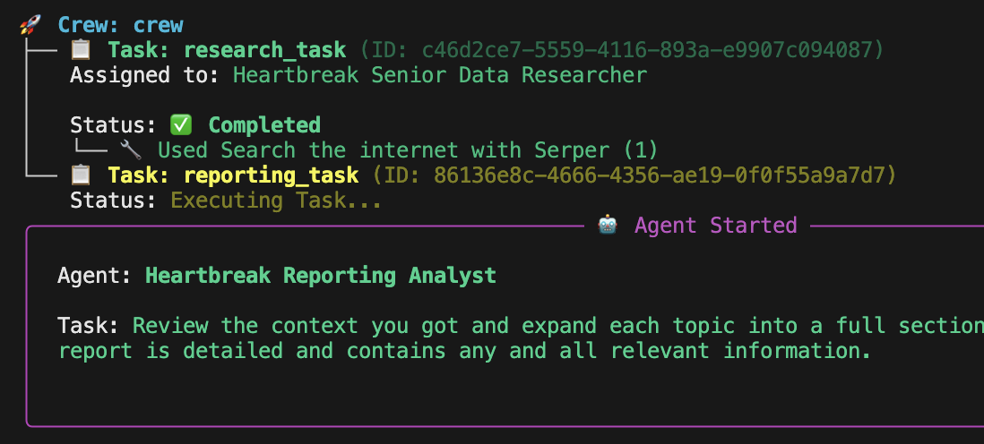

Slide 19
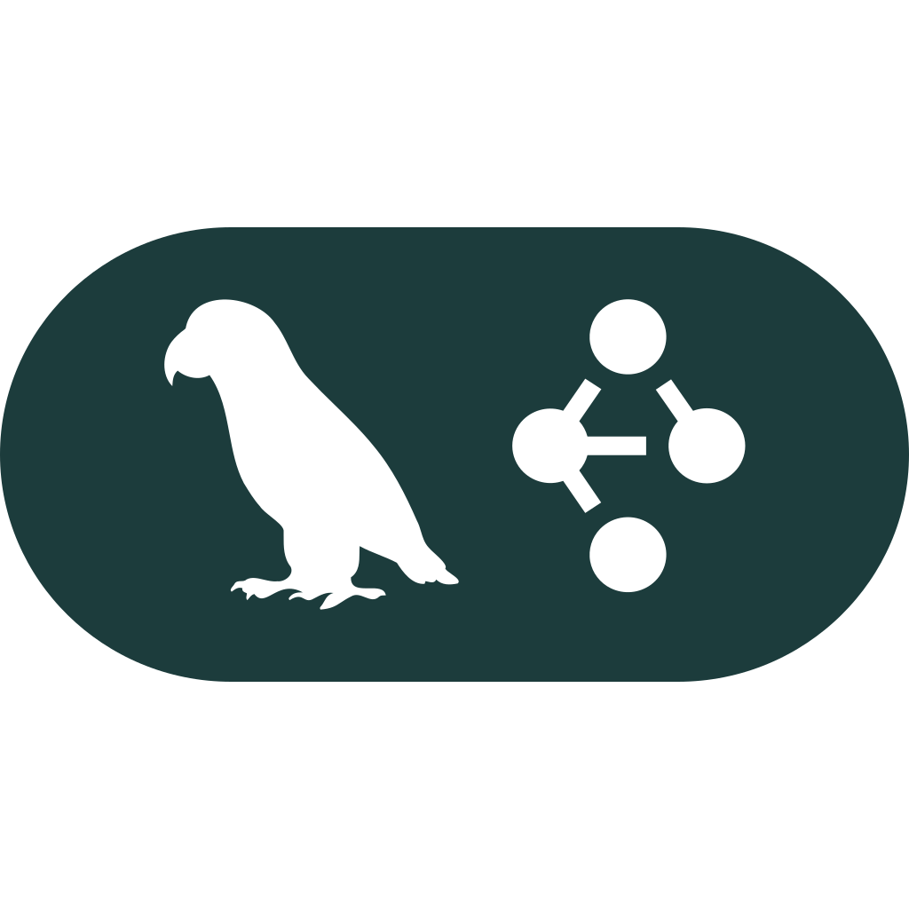
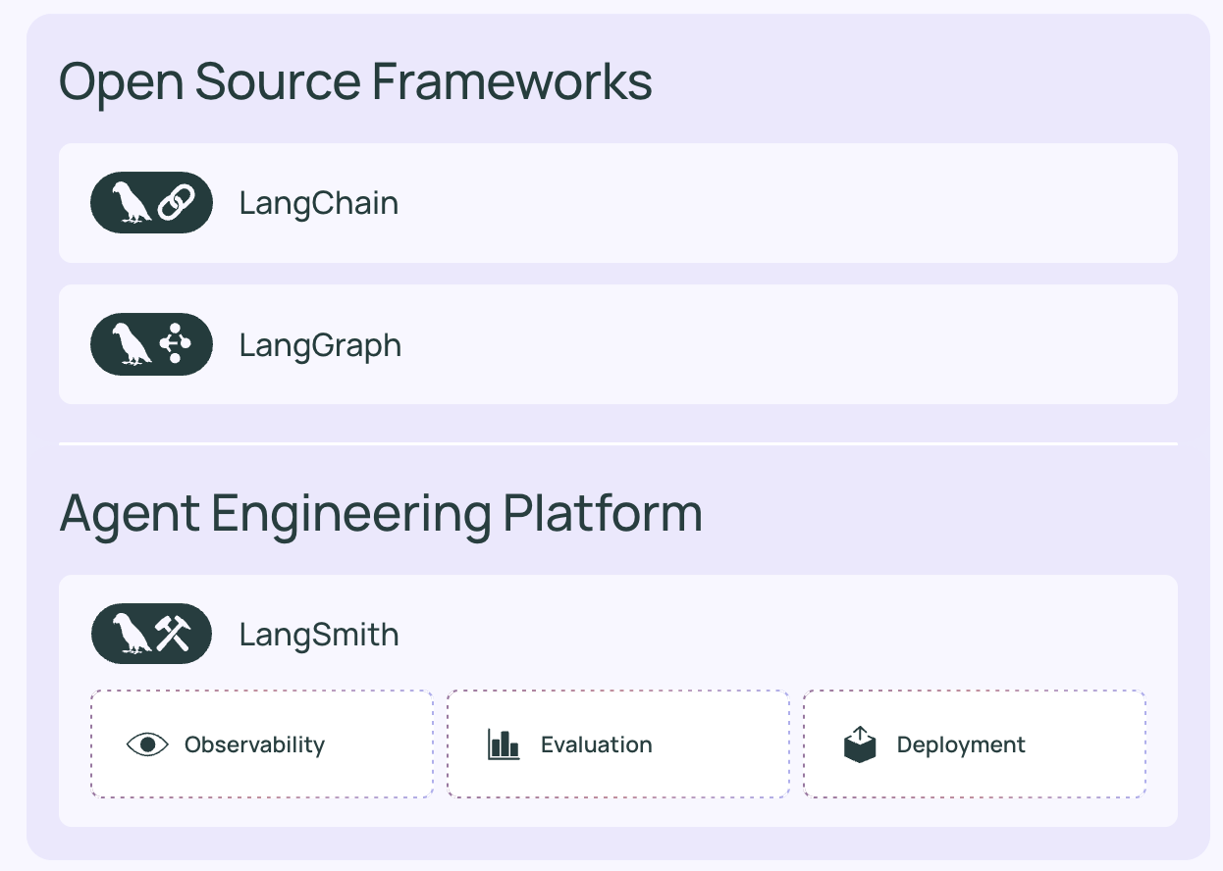
The Pioneer: LangGraph
Philosophy: LLM is a node in a graph of logic flow.
Graph enables explicit control on every step, decision, and loop. Try to achieve reliability and debugging. Part of LangChain ecosystem.
Characteristics: Explicit control on the flow.

Slide 20
agent_builder = StateGraph(MessagesState) # Add nodes agent_builder.add_node("llm_call", llm_call) agent_builder.add_node("tool_node", tool_node) # Add edges agent_builder.add_edge(START, "llm_call") agent_builder.add_conditional_edges( "llm_call", should_continue, ["tool_node", END] ) agent_builder.add_edge("tool_node", "llm_call")
Graph has a shared state
Start
LLM Node
Call tool?
No
End
Yes
Stop when no tool is called
Tool
Loop back to LLM after tool call

Slide 21
Why Graph of LLM Nodes?
Low level control of flow. Micromanaging “Anak Intern”
Enable looping, e.g. for self correction, for repeated improvements
Define the exit criteria of a flow = controllable quality.
Focus on orchestration: durable execution, human-in-the-loop
agent = create_agent( # ... tools=[execute_sql_tool, read_data_tool], middleware=[ HumanInTheLoopMiddleware( interrupt_on={ "execute_sql": True, "read_data": False, # Safe operation, no approval needed

Slide 22
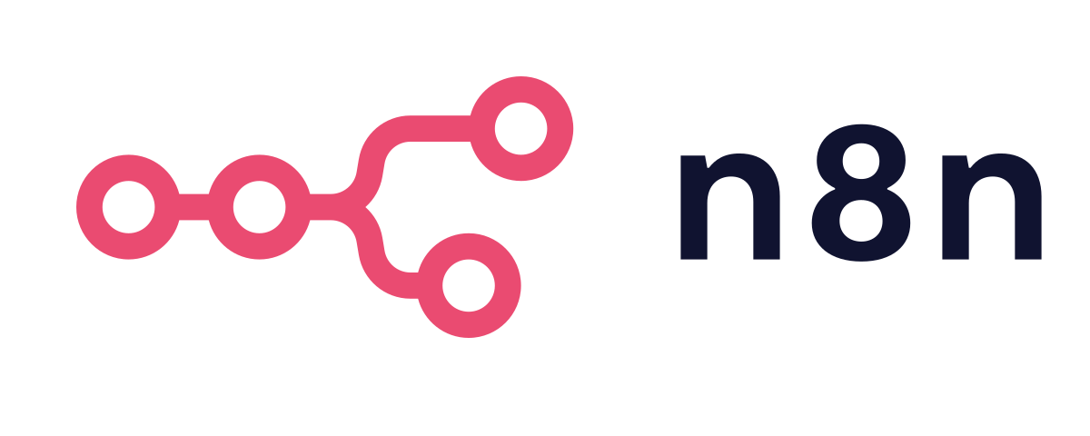
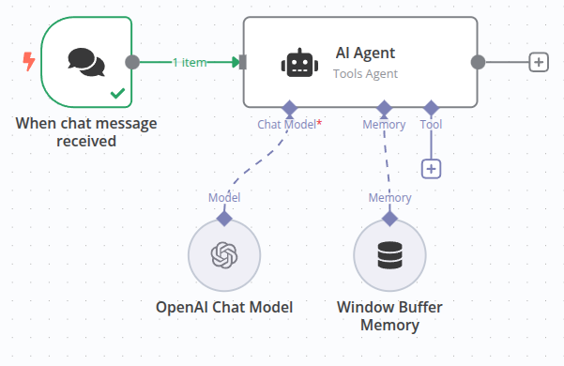
The No Code: n8n
Philosophy: no code workflow automation.
Historically, n8n was a generic workflow automation. Since LLM boom, adopted for AI workflow automation.
Characteristic: Easy to use, drag and drop interface.

Slide 23
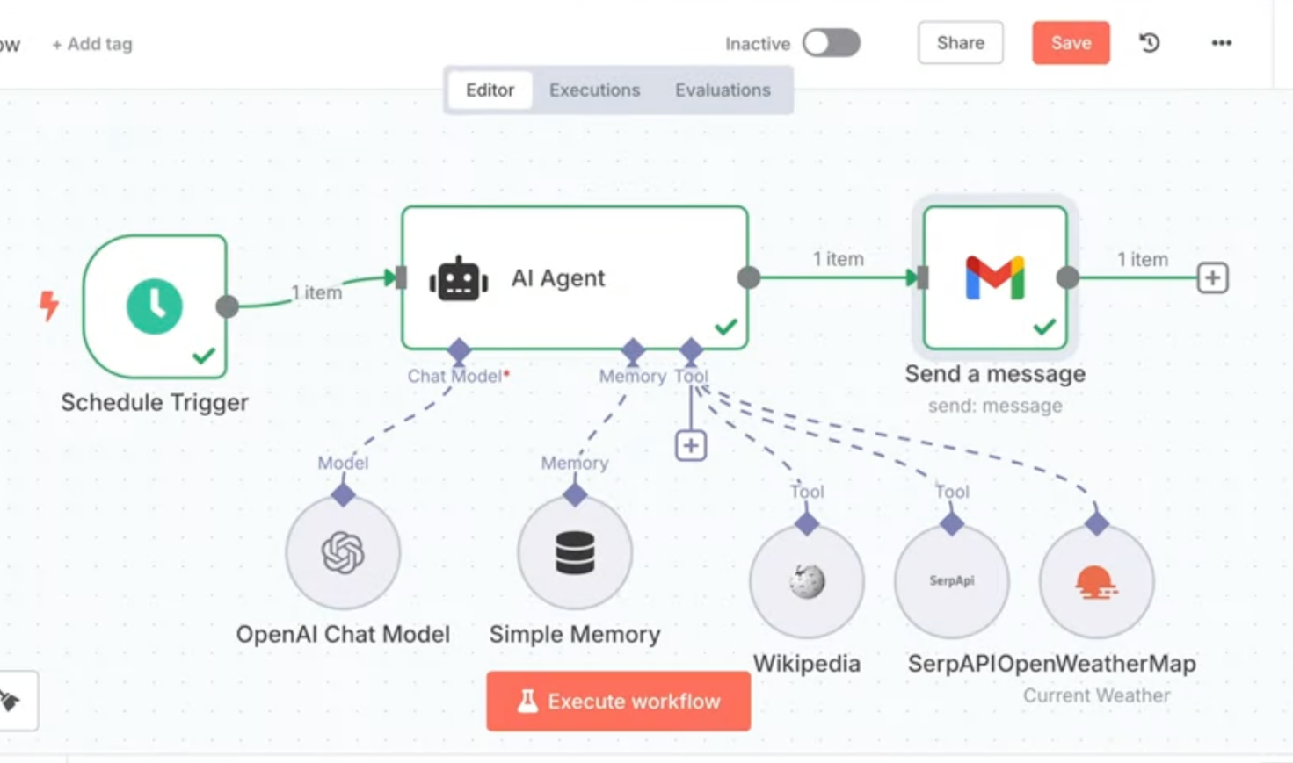
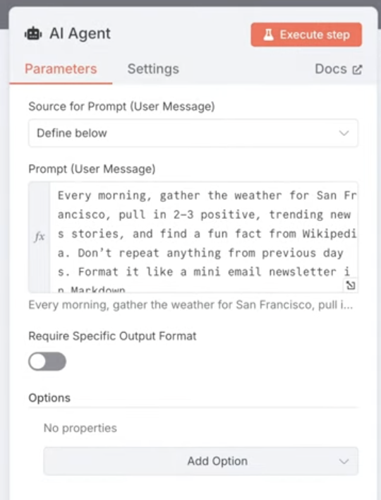

Slide 24
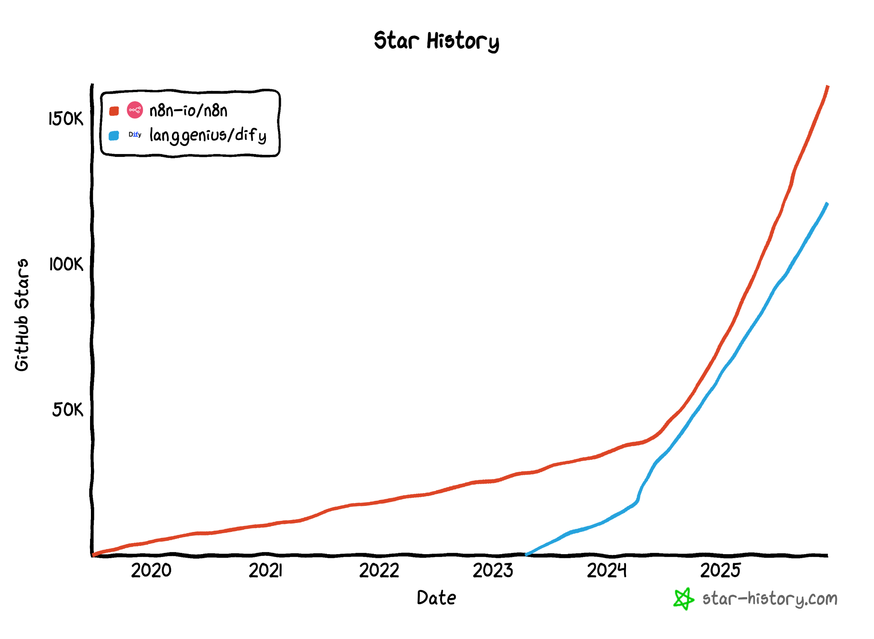
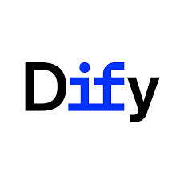

Slide 25
Why No Code?
Speed of development.
LLM apps is configurable.
Democratize to non less technical people.
Easier to understand graph (WYSIWYG).

Slide 26

The Vendor Centric: Agent Development Kit (ADK)
Philosophy: Asynchronous event based
Events are the fundamental units of information flow within the ADK. All that happens treated as events such as input to the LLM, agent reasoning, calling tools, callback.
Characteristics: Native integration to Google product such as Google Search, Vertex (Google Cloud)

Slide 27
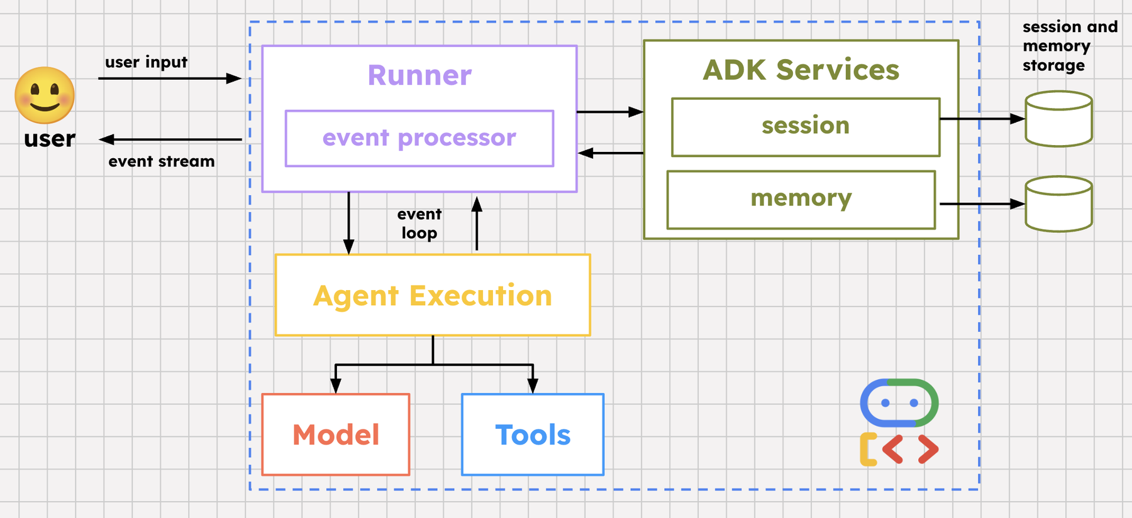

Slide 28
def search_train(origin: str, dest: str, date: str, pax: int):...
def book_train(code: str, name: str):...
root_agent = Agent(
model=MODEL,
...
instruction="You are a travel agent for search and book train.",
tools=[search_train, book_train],
)
Agent Declaration.
Usually LLM, Memory, tool, etc configured here
This is called tools

Slide 29
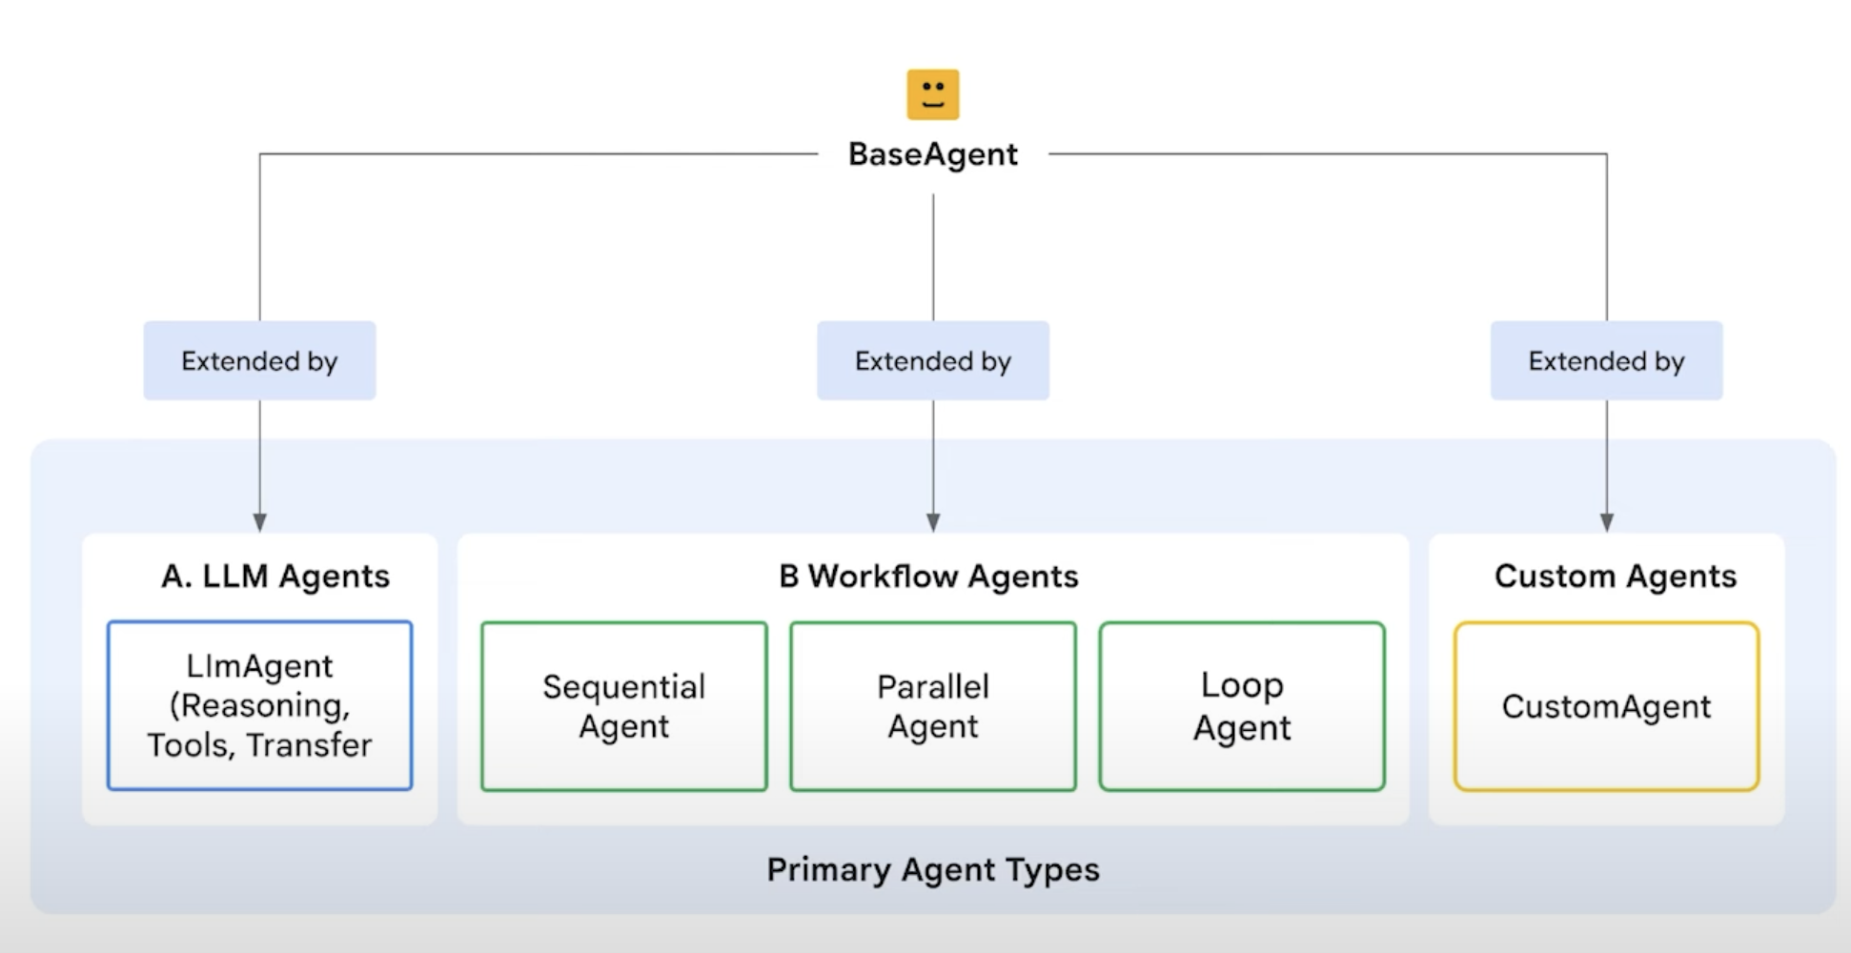
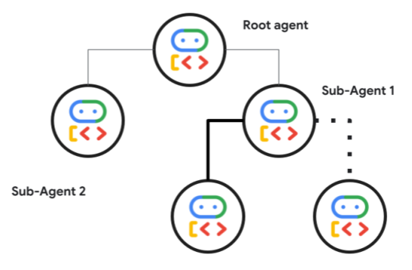
Generalist: Can do hierarchical or graph / workflow

Slide 30
Why Event Based
Easy to handle signal
Control flow based e.g. transferring to other agents, guardrail
Easy to debug, audit, and easy to understand agent’s behavior
print(f"\n>>> User Query: {query}")
async for event in runner.run_async(...):
if event.is_final_response():
break
print(f"<<< Agent Response: {final_response_text}")

Slide 31
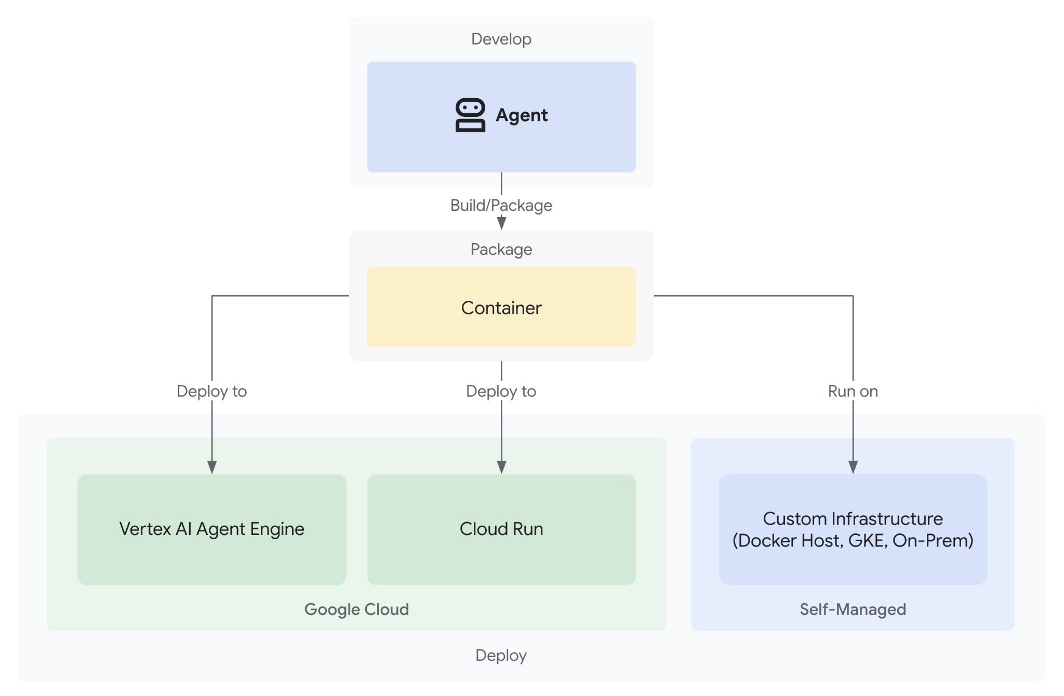
Why Vendor-Centric
Easier to “production phase”
Enterprise-grade features e.g. auditability
Easier to use vendor’s services e.g. Google Search
Worth to check: Microsoft’s
Agent Framework
Semantic Kernel

Slide 32
The Design Philosophy Comparison
Framework | Philosophy
CrewAI | Simple abstraction or roles. Dynamic collaboration, creative problem solving across agents.
LangGraph | Low level control for deterministic graph task. Control of reliability, HITL. Mature LangChain ecosystem.
n8n | Drag & drop = speed of development, easy to understand as it is visual
Google ADK | Event based & productionization. Seamless to use Search and GCP.

Slide 33
Several Takes from Design Philosophy
Actually… All of them able to do graph.
BUT not all of them can do collaborative agents easily.
  LangGraph and n8n stick to the graph.
  ADK has delegation, but it is hierarchical, not democratic, but OK partially collaborative
Different problem requires different mode.
  Creative, problem solving: collaborative
  Deterministic steps: graph

Slide 34
The Component and Features

Slide 35
The Components and Features
Agent. Consist of instruction / prompt.
Memory. To have a constructive conversation.
Knowledge. Information for grounding (RAG).
Tools. Means for agent to do actions.

Slide 36
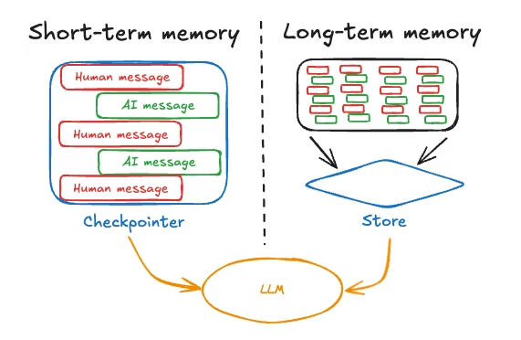
Memory
Remember past interactions and use it as part of context to deliver high quality result.
Two components: short term, long term memory.

Slide 37
Memory Comparison
Memory | Characteristic | Comparison
CrewAI | "Set-it-and-forget-it". Not clear how to customize. | Easy, not flexible
LangGraph | Flexible and rich of method, coding based. | Not easy, flexible
n8n | Plug and play but limited features. | Easy, not flexible
ADK | Structured and production-ready, precisely schedule summarization with parameters e.g. overlap size | Medium, flexible

Slide 38
RAG (Retrieval Augmented Generation)
Uses knowledge to ground the LLM.
Commonly uses:
Embedding to convert text into vector
Vector database to semantically search knowledge
Input
Output
db

Slide 39
RAG Comparison
Framework | RAG Characteristic | Comparison
CrewAI | Abstracted in Knowledge concept (using ChromaDB). Chunking and overlap as config. | Easy, quite flexible
LangGraph | Flexible and rich of method, yet requires the most manual setup, coding based. | Not easy, super flexible
n8n | Plug and play with vector store. Rich of features such as rerank. | Easy, flexible
ADK | Easy to productionize with Vertex AI vector db. Integrate to Agent with Built-in tools | Easy, flexible

Slide 40
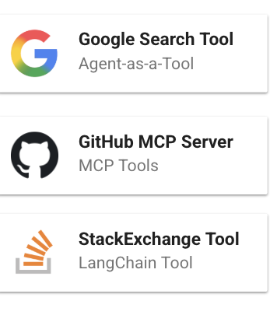
Tools
Tools is list of tools AI can pick and use.
Imagine: Bug Assistant AI
Read bug issue
Search how to solve
Fix and submit PR

Slide 41
Tools Comparison
Framework | Ready to use Tools | Comparison
CrewAI | CrewAI tools (30+) and LangChain Tools https://docs.crewai.com/en/concepts/tools | Super rich.
LangGraph | LangChain Tools (1000+) https://docs.langchain.com/oss/python/integrations/tools | Super rich.
n8n | n8n integrations (1000+) https://n8n.io/integrations/ | Super rich
ADK | ~20 tools. Plus: Google Search, GCP Tools https://google.github.io/adk-docs/tools/third-party/ | Limited

Slide 42
Several Takes from Component & Features
All frameworks covered similar features.
Ease of use: CrewAI and n8n take easy-to-use approach with limited flexibility, a lot of detail is wrapped inside.
Code-centric: LangGraph and ADK, more effort which comes with more flexibility.
LangChain tools (code) and n8n integrations (no code) seems unbeatable in each area with 1000+ integrations, relies on community

Slide 43
Scalability and Observability

Slide 44
Scalable Deployment
Framework | Deployment Option | Scalability
CrewAI | Paid: CrewAI Agent Operation Platform (Enterprise) Free: Unclear, but there’s community blog (ref). | Paid centric
LangGraph | Paid: LangSmith Free: Unclear, but there’s community blog | Paid centric
n8n | Paid: Enterprise n8n; versioning, auth SSO Free: Clear deployment guidance using queue pattern (ref) | Both Paid and Free
ADK | Paid: Vertex AI on GCP, Cloud Run Free: Docker deployment with example (ref) | Both Paid and Free

Slide 45
Observability
Framework | Observability for Open Source Option | Observability
CrewAI | Langfuse integration using OpenTelemetry via the OpenLit SDK | OK
LangGraph | Unclear, langchain can connect with langfuse but there are issues in the community. | Unclear
n8n | Unclear how to monitor the n8n. They provide “metrics” API. | Limited
ADK | Many options, there are 9 options. Promising one: AgentOps. | Rich

Slide 46
Several Takes on Scalability and Observability
Scalability deployment is unexpected.
Observability is also unexpected.
n8n observability is limited; but understandable since it is a platform.
Framework | Scalability | Observability
CrewAI | Paid centric | OK
LangGraph | Paid centric | Unclear
n8n | Both Paid and Free | Limited
ADK | Both Paid and Free | Rich

Slide 47
The Mental Model

Slide 48
Compiled Comparison
Framework | Memory | RAG | Tools | Scalability | Observability | Learning Curve | Avg Score
CrewAI | ⭐⭐⭐⭐ Easy, not flexible | ⭐⭐⭐⭐ Easy, flexible | ⭐⭐⭐⭐⭐ Super rich. | ⭐⭐⭐ Paid centric | ⭐⭐⭐⭐ OK | ⭐⭐⭐⭐ Easy | 4.0
LangGraph | ⭐⭐⭐⭐ Not easy, flexible | ⭐⭐⭐ Not easy, super flexible | ⭐⭐⭐⭐⭐ Super rich. | ⭐⭐⭐ Paid centric | ⭐⭐⭐ Unclear | ⭐⭐ Hard | 3.3
n8n | ⭐⭐⭐⭐ Easy, not flexible | ⭐⭐⭐⭐⭐ Easy, flexible | ⭐⭐⭐⭐⭐ Super rich | ⭐⭐⭐⭐⭐Paid and Free | ⭐⭐⭐ Limited | ⭐⭐⭐⭐⭐ Intuitive | 4.5
ADK | ⭐⭐⭐⭐ Medium, flexible | ⭐⭐⭐⭐⭐ Easy, flexible | ⭐⭐ Limited | ⭐⭐⭐⭐ Paid and Free | ⭐⭐⭐⭐⭐ Many Options | ⭐⭐⭐ Medium | 3.8

Slide 49
The Mental Model
Framework | Mental Model / Sweet Spot
CrewAI | "The Manager's Choice." Use when the problem requires autonomous teamwork and specialized roles.
LangGraph | "The Engineer's Choice." Use when you need to guarantee specific logic paths and manage state transitions precisely.
n8n | "The Business Choice." Use for quick integration of AI reasoning into existing business workflows
Google ADK | "The CTO's Choice." Use for high-security, high-scale, production agents within the Cloud ecosystem.

Slide 50
Honourable Mention

Slide 51
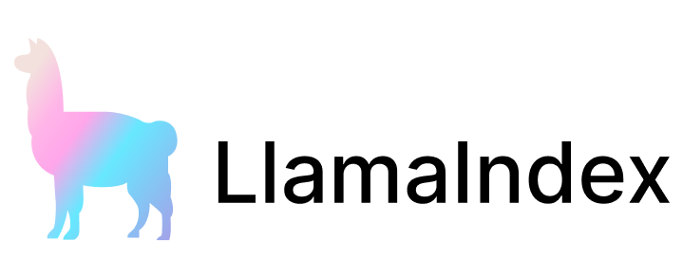
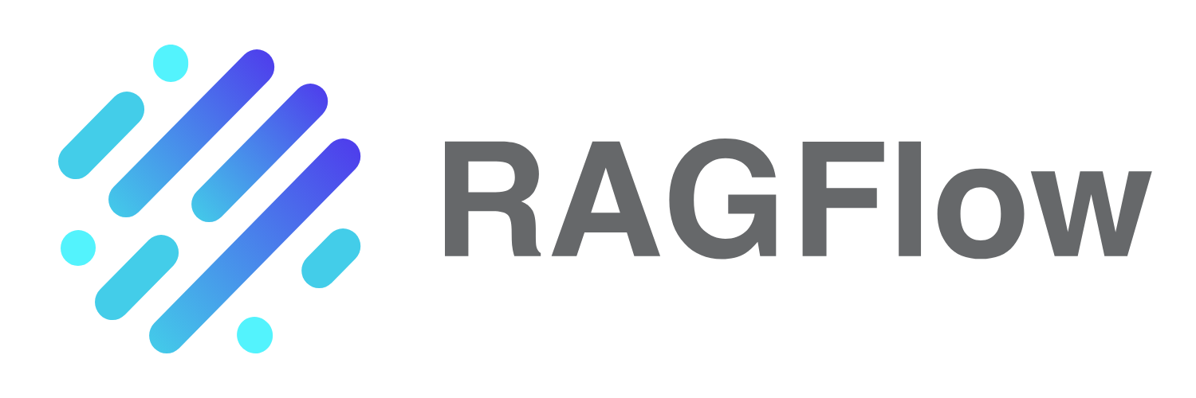
RAG-focused Framework: RAGFlow, LlamaIndex
Focuses on how to easily index doc and create agent on top of it.
Teach you what to expect in a good RAG solution such as:
Different document treatment (Q&A, etc)
Chunking method
Summarization method, e.g. RAPTOR

Slide 52
LLM Apps by Programming, not Prompting
https://dspy.ai/
See example below, instead of writing some prompting, dspy use a syntax like function definition.
math = dspy.ChainOfThought("question -> answer: float")
math(question="Two dice are tossed. What is the probability that the sum equals two?")

Slide 53

LLM Router & Fallback Library
Most prominent: LiteLLM
OpenAI API compatible. Consistent input / output
Fallback logic across multiple deployments
Set Budgets & Rate limits
from litellm import Router router = Router( model_list=[ {"model_name": "gpt-3.5-turbo", "litellm_params": {}}, {"model_name": "gpt-4","litellm_params": {}} ], fallbacks=[{"gpt-3.5-turbo": ["gpt-4"]}] # 👈 KEY CHANGE )

Slide 54
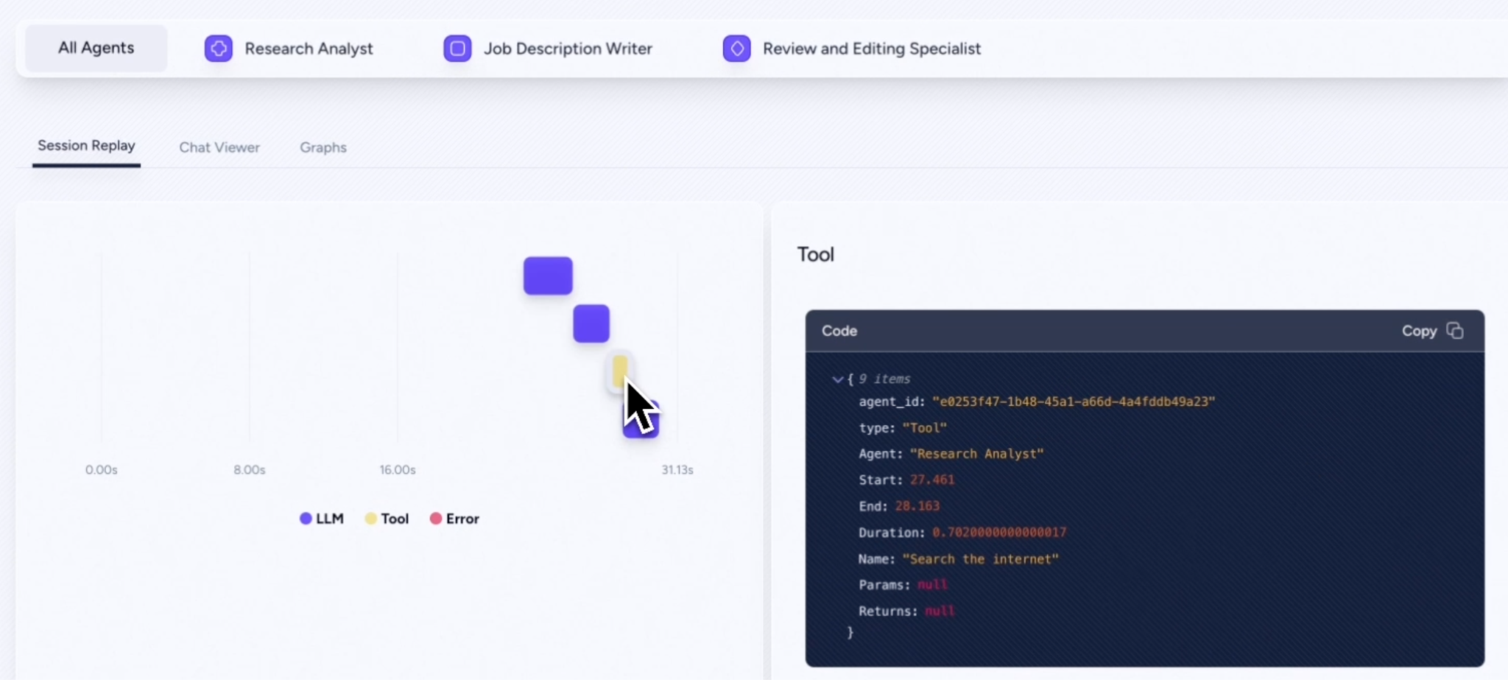
LLMApps Observability Tools: AgentOps

Slide 55
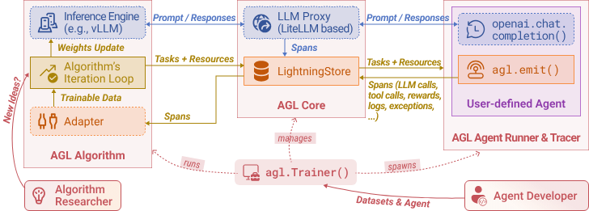
LLM Apps Training Library with Reinforcement Learning
Optimize prompting and other agentic configuration using reinforcement learning.
E.g. Microsoft’s Agent Lightning

Slide 56
Closing

Slide 57
LLM App Dev Ecosystem is still young… (<4 years)
Out of all the options, there are more similarity than difference, especially for common use cases.
More hands on is the key.
Actionables: Pick the easiest one, take one use case, go on and develop one.
As you understand one framework, it will get easier to learn the others.

Slide 58
Thank You

